Slide 1
Initial Problems of Pakistan or Post Partition Problems
By: Muhammad Ajmal Khan

Slide 2
Formation of the State
The Muslims got their independence in 1947 from the shackles of British Raj and Hindu atrocities. The efforts and political struggles of charismatic leaders like Muhammad Ali Jinnah, Sir Syed Ahmad Khan, Allama Iqbal and other Muslim leaders resulted in the emergence of new state on 14th August 1947. The new state was supposed to be a separate homeland for the Muslims of India.
The formation of a state was not an easy task for the Muslims of Subcontinent. Thousands of people lost their lives (Muslims, Hindus and Sikhs) and millions of people lost their relatives, siblings, properties etc.

Slide 3
Elements of a State
A state is composed of four elements, they are:
Physical bases of the state
Population (It’s always the population that makes the state)
Territory (There can be no state without a fixed territory: Land, water and Space)
Political bases of the state
Government (The working agency of the State)
Sovereignty (The supreme and final legal authority: Internal and External Sovereignty)

Slide 4
Difference between State and Government
State consists of population, territory and government while the Government is part of the state. State is a permanent institution while government has its specific tenure.
Branches of Government
Legislature: Matters of social, political and economic concerns are discussed
Executive: Enforcing the laws passed by the legislature
Judiciary: Administration of justice

Slide 5

What is Government

Slide 6
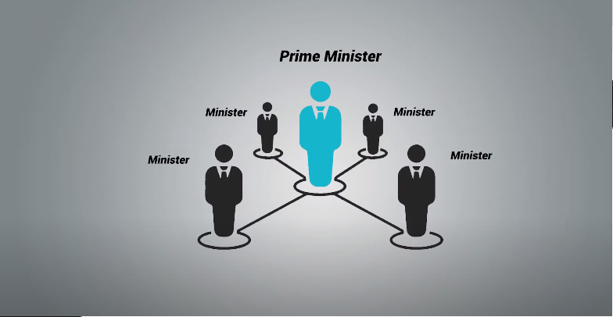
Cabinet

Slide 7


Slide 8
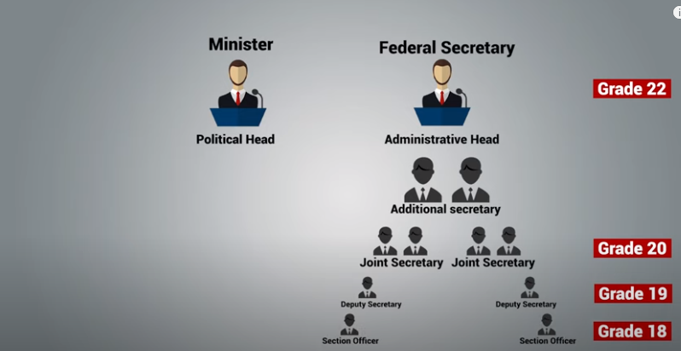

Slide 9
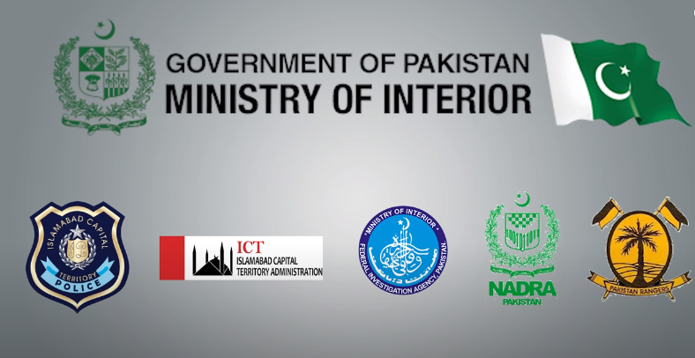

Slide 10
Initial Problems of Pakistan
Choice of Capital and Establishment of Government (Lack of offices and equipment's to run the state affairs, Jinnah took the office of governor general of Pakistan and Liaquat Ali Khan as Prime Minister of Pakistan. Officers were installed in Barracks and private buildings)
Unfair Boundary Distribution (Sir Cyril Redcliff misused his powers and handed over the Muslim majority areas like Gurdaspur, Ferozpur, Jullandar to India and left the Kashmir as a bone of contention between India and Pakistan)
The massacre of Muslim Refugees in India (To Sikhs, The creation of Pakistan was the partition of Punjab and they rejected the creation of Pakistan, when the Pakistan was created, the Sikhs and Muslims migration resulted bloodshed. Hindus misused the opportunity and attacked Muslims)
Rehabilitation of refugees (The government of Pakistan took immediate measures to accommodate the refugees)
Division of Military and Financial Assets (Pakistan was promised Rs: 750 million but the Indian government returned just 200 millions.)
Electricity Problem (Electricity system of West Punjab was disrupted because all the power stations were installed in India)

Slide 11
Problems of Princely States: The Muslim majority princely states were given to India by British government which left unending disputes between India and Pakistan.
Lingual Problems: The Bengalis were in Majority due to which the demanded Bengali as the official language and it was opposed by West wing of Pakistan.
Leadership Vacuum: The early death of Muhammad Ali Jinnah and Liaquat Ali Khan left a leadership vacuum in that scenario which was never filled by any competent leader.
Indus Water Basin Treaty: Pakistan had water dispute with India which was settled down in 1960 as Water Basin treaty.
Political riots: Shia Sunni disorder started during post partition era. Later one, the Ahmadi Movement also took place which resulted in the imposition of Martial Law.

